Slide 1
Threading
Concurrent Programming
Nikolay Pavlov

Slide 2
Processes, Threads…
And Other Monstrosities

Slide 3
Processes and Threads
A process is a container of resources used when executing a program and has:
Unique identifier
Private virtual address space
List of handles of OS resources
Security context
One or more threads
Threads within a process share same memory
A thread is a sequence of instructions which the OS schedules for execution
Notes:
Process, in simplest terms, is an executing program.

Slide 4
Threads
A thread is a sequence of instructions, i.e. a procedure / method
These procedures / methods cannot return a value!
Threads always end when they execute their last instruction
Each thread has a Stack
Its own and private local variables
Their own exception tracing
All threads of a process share the same heap
This is how threads exchange data – they read and write from the heap

Slide 5
Demos
Create a Thread
Pass data to a thread
Wait for a thread to complete:
Variable flags
Thread.Join()

Slide 6
Exercises
Create your first thread
Notify when thread is done
Create five threads that generate a random number each; then sum the results and print it on screen

Slide 7
Multitasking
Multiple tasks run at the same time
Best scenario: Number of tasks <= number of CPUs (cores)
Reality: Number of tasks > number of CPUs
Scheduling is required
Notes:
Modern CPUs contain multiple cores. In this lecture, we will use the term CPU to notify a processing core, not the number of physical chips on the motherboard.

Slide 8
Two Types of Multitasking
Cooperative – threads explicitly yield control:
Pre-emptive – OS scheduler takes control away.
Thread 1
Thread 2
Thread 3
yield
yield
yield
yield
Thread 1
Thread 2
Thread 3

Slide 9
Quantum
The amount of time given to any thread to execute before execution is given to another thread.
Approximately 20 milliseconds for Windows.
Varies per foreground and background processes.
A thread can yield before the end of its quantum:
Wait for an event.
Simply yield.
Thread 1
Thread 2
Thread 3
wait

Slide 10
Context Switch
Switches execution from one thread to another
Context switch involves:
Save CPU registers
Determine which thread to execute next
If the next thread is from another process, switch address space
Load registers from the next thread into CPU
CPU cache must be repopulated → cache misses
Notes:
When the operating system switches the execution from one thread to another, we have a context switch.

Slide 11
Windows Scheduler
A thread is scheduled to each CPU according to priority
Windows schedules threads from Highest → Lowest until all CPUs are busy.
Windows allows a thread to run for a time quantum
When quantum expires, Windows performs a context switch
A thread can voluntarily yield earlier
Usually by waiting for something (e.g., input from keyboard, file, network)
Windows doesn’t schedule waiting threads
In practice, most threads in the system are in waiting state

Slide 12
Thread Priorities
Each thread has priority
Lowest – Below Normal – Normal – Above Normal – Highest
Can boost / lower priority of threads to guarantee that no threads are starved for processor time:
When a thread receives user input
When a process is brought to foreground
When a waiting threads awakens

Slide 13
Demo
Thread priorities

Slide 14
When to Play with Thread Priorities
Don’t
When to use low priority:
Long-running computational tasks
To avoid affecting other processes
When to use high priority:
Tasks that need to do something immediately

Slide 15
Thread State
Initialized
Ready to run
Running
Waiting – waiting for an event, suspended, blocked
Terminated
When its execution code comes to an end

Slide 16
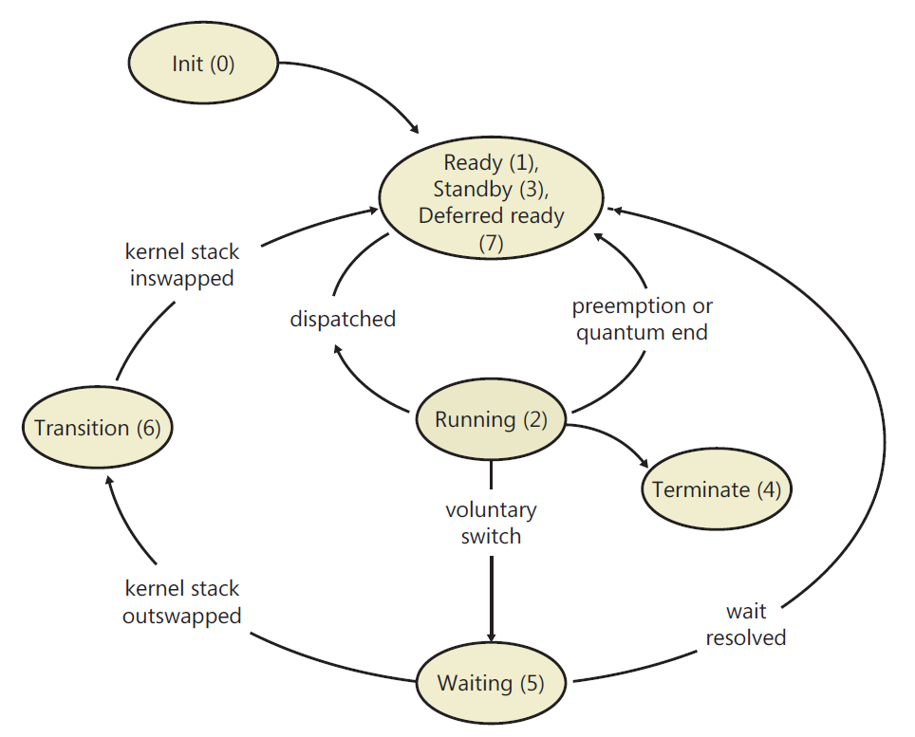
Thread State Transition

Slide 17
The Price of a Thread
Context
General data
CPU registers
Size in bytes: ~ 700 for x86 and ~ 1200 for x64
Stack (actually, there are two stacks)
1MB for the user mode stack
DLL thread attach / detach notifications
Context switches

